Slide 1
STOCK MARKET PREDICTOR:
Using the Volatility Index to
Predict S&P 500 Future Returns
Coded and presented by Mark Lech

Slide 2
Important disclaimer:
Past performance may not be indicative of future results. The information on this site is provided for discussion purposes and should not be considered as investment advice. There is no assurance that the future performance of any investment, strategy, or product made reference to directly or indirectly here will be profitable, equal any historical performance levels, or be suitable for your portfolio.

Slide 3
The “Vix”
The Vix is the Chicago Board Options Exchange's Volatility Index, a measure of the stock market's expected volatility.
It is often referred to as the fear index or fear gauge.
The higher the VIX, the greater the level of fear and in the market.
Levels above 30 indicate high levels of uncertainty.

Slide 4
The S&P 500
The “S&P 500” is the Standard and Poor's 500 index.
It is a stock market index tracking the stock performance of 500 of the largest companies listed on the stock exchange.
It is one of the most commonly followed equity indices.
It is the index frequently referred to as "the market".

Slide 5
The Vix + The S&P 500 + Machine Learning = Something Good
Machine learning models have determined a straight-forward way to use elevated levels of the Vix to help predict a positive gain for the S&P 500 index one year into the future.
The models have shown that when the Vix rises above 35, and especially above 50, the historical return on the S&P 500 over the following year has been very positive.

Slide 6

Model Roadmap
3 machine learning modules were built
and run in succession
1
2
3
Neural
Network
Discovery
Neural
Network
Optimization
Linear &
Non-linear
Regression

Slide 7
Model Roadmap
1
2
3
Model 1: Looping through a Neural Network to Find the Best Candidates
Neural network run in Google Colaboratory.
21 ticker symbols were fed in as possible inputs. They resulted in 210 unique pairs.
2 securities were possible outputs to measure results.
Joined with the 210 pairs, there were 420 possible combinations to test.

Slide 8
Model Roadmap
1
2
3
Model 1: Looping through a Neural Network to Find the Best Candidates
21 Potential inputs:
S&P 500 (^GSPC)
Dow Jones Industrial Average (^DJI)
NASDAQ Composite (^IXIC)
Russell 2000 (^RUT)
S&P Consumer Staples Sector (XLP)
S&P Energy Sector (XLE)
S&P Financial Sector (XLF)
S&P Health Care Sector (XLV)
S&P Industrial Sector (XLI)
S&P Materials Sector (XLB)
S&P Real Estate Sector (XLRE)
S&P Technology Sector (XLK)
S&P Utilities Sector (XLU)
S&P Communication Services (XLC)
S&P Consumer Discretionary (XLY)
CBOE Volatility Index (^VIX)
CBOE 3-Month Volatility (^VIX3M)
Crude Oil Futures (CL=F)
Treasury Yield 10 Years (^TNX)
Bitcoin USD (BTC-USD)
CMC Crypto 200 Index (^CMC200)
2 Possible Outputs:
SPY (an ETF that mirrors the S&P 500)
USO (an ETN made up of oil futures)

Slide 9
Model Roadmap
1
2
3
Model 1: Looping through a Neural Network to Find the Best Candidates
Process:
Test 420 input/output combination via an automated loop.
Record findings, looking for accuracy results over 70%.
Adjust features and other variables.
Run the process run again.

Slide 10
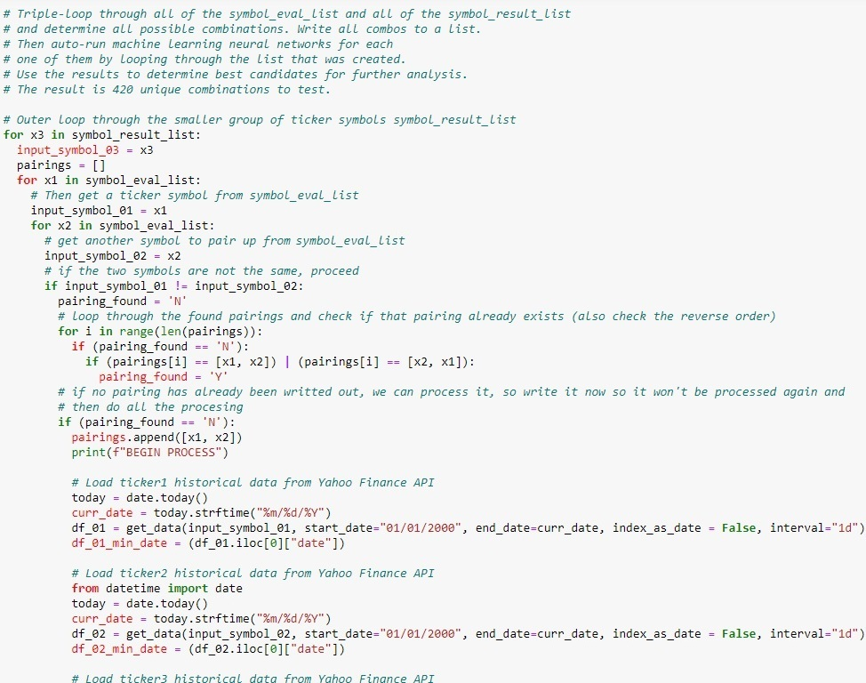
Model Roadmap
1
2
3
Model 1 Loop Logic
The filter process for looped through 21 input symbols to find unique pairs, resulting in 210 conbinations. The outer loop joined with two output symbols, for a total of 420 combinations.

Slide 11
Model Roadmap
1
2
3
Model 1: Looping through a Neural Network to Find the Best Candidates
Findings:
For model 1 inputs, the closing price features of two symbols (VIX and VIX3M) produced consistently higher accuracies.
For outputs, the S&P 500 return for one year in the future produced higher overall scores.
Result:
VIX and VIX3M were passed to Model 2 as inputs, with the S&P 500 as the output.

Slide 12
Model Roadmap
1
2
3
Model 2: Optimizing the Neural Network
VIX and VIX3M closing values were inputs.
S&P 500 return for one year was the output.
Data was optimized with KerasTuner with a maximum of 10 hidden layers and 200 nodes.
A second neural network model was then run using the optimized variables.
The results yielded an accuracy of 77.4%.
.

Slide 13
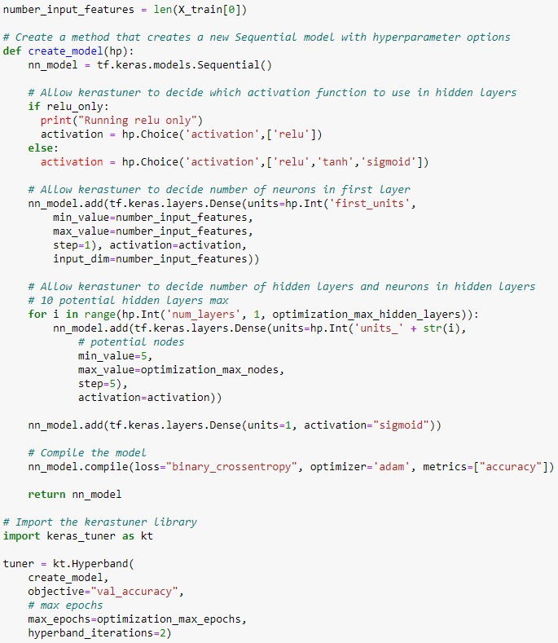
Model Roadmap
1
2
3
Model 2 Optimizer Logic
KerasTuner auto-optimizer tested various numbers of hidden layers, nodes and epochs.

Slide 14
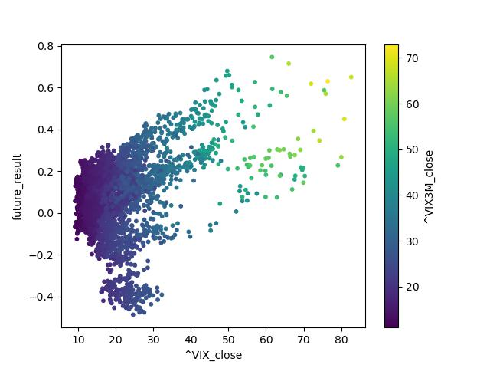
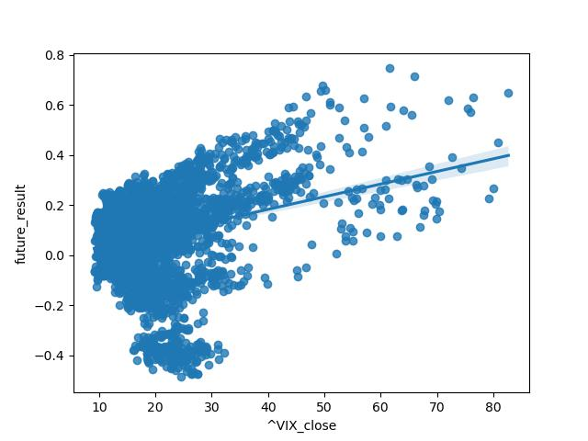
Model Roadmap
1
2
3
Model 2: The VIX and VIX3M inputs and S&P 500 outputs were then plotted:
Very few negative returns on the lower right of the chart.
Symbol VIX had a more defined lower boundary than VIX3M.
VIX and the S&P 500 were then passed to Model 3.

Slide 15
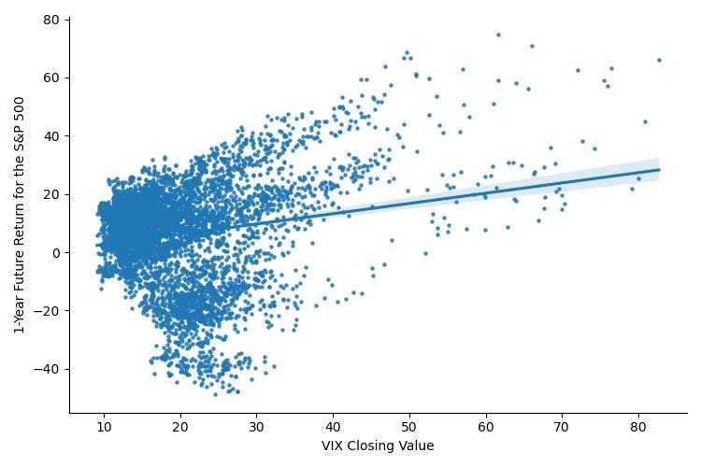
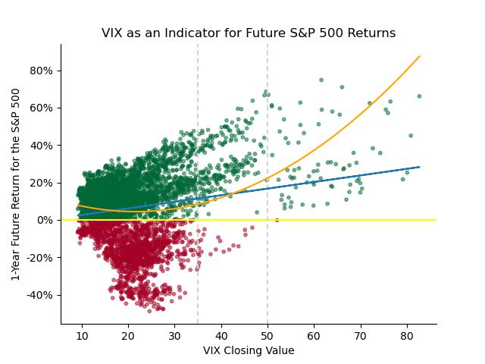
Model Roadmap
1
2
3
Model 3: The VIX and S&P 500 were plotted with linear and non-linear regressions
Additional trend lines, formatting and colors made the relationship easy to see.
S&P 500 returns improved significantly with VIX values above 35 and 50.

Slide 16
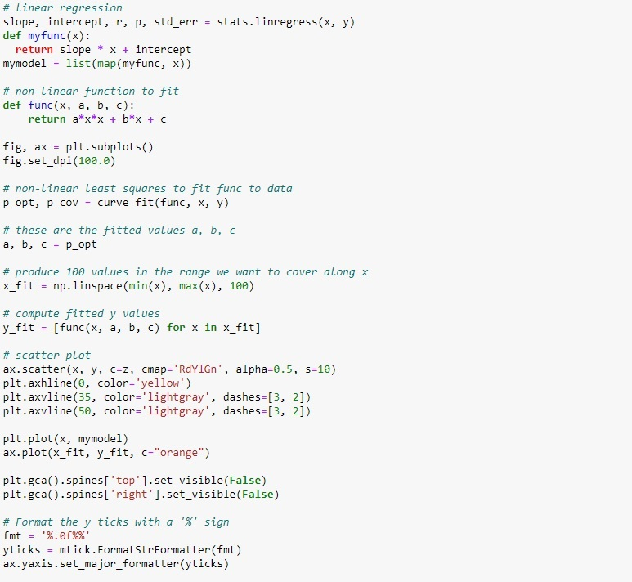
Model Roadmap
1
2
3

Slide 17
Model Roadmap
1
2
3
Model 3:
The coefficient of determination might seem concerning: 0.03.
Due to wide variation at the lower VIX levels and a high positive spread in the upper.
Real-world application is in uncovering and isolating positive future returns by using VIX upper ranges.
In this situation, the probability of a positive outcome is much more important.

Slide 18
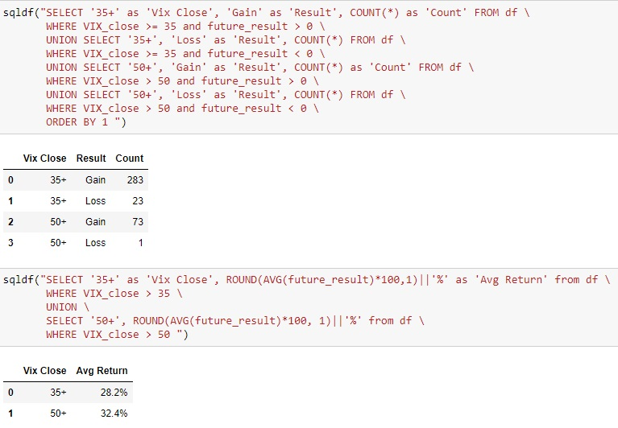
Model Roadmap
1
2
3
Model 3:
SQL confirmed the VIX/S&P 500 relationship.
When the VIX is above 35, the S&P 500 rose 283 / 309 times (92.6%).
When the VIX is above 50, the S&P 500 rose 73 / 74 times (98.5%).
Model 3 was exported and embedded at stock-forecaster.herokuapp.com where the user can enter a VIX value.

Slide 19
Technologies
Python
Flask
GitHub
Pandas
Matplotlib
Seaborn
SQL
Numpy
Scipy
Google Colaboratory
Jupyter Notebook
APIs (internal and external)
Scikit-learn
Scikit-learn: LinearRegression
Scikit-learn: StandardScaler
Scikit-learn: MinMaxScaler
Scikit-learn: train_test_split
Scikit-learn: accuracy_score
KerasTuner
TensorFlow
Machine Learning
Neural Networks
HTML
CSS
Pickle
Tableau
Heroku

Slide 20
Conclusion
1
2
3
The historical average of the Vix is just north of 20 but values of the Vix from 2000 - 2023 show long periods of relative calm interrupted by spikes in volatility.
Historically, the models demonstrate that significant VIX spikes above 35, and especially above 50, are signals that the S&P 500 has been higher one-year from that point.
The most prominent examples are when the Vix is above 35, which has resulted in a positive return 92.5% of the time.
A Vix over 50 has a smaller sample size but a higher positive frequency of 98.6%

Slide 21

Free templates for all your presentation needs
For PowerPoint and Google Slides
100% free for personal or commercial use
Ready to use, professional and customizable
Blow your audience away with attractive visuals

Slide 22
Demo Time

Slide 23
Thank you!

